Slide 1

User Manual
SAP - APPROVAL WORKFLOW
User Manual - SAP approval workflow

Slide 2
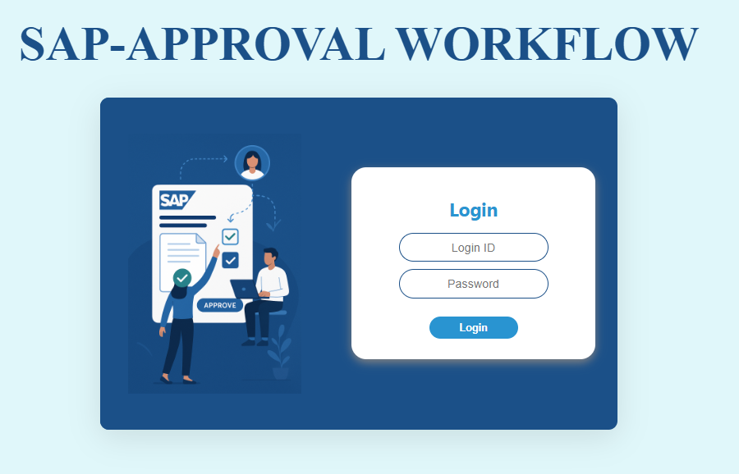
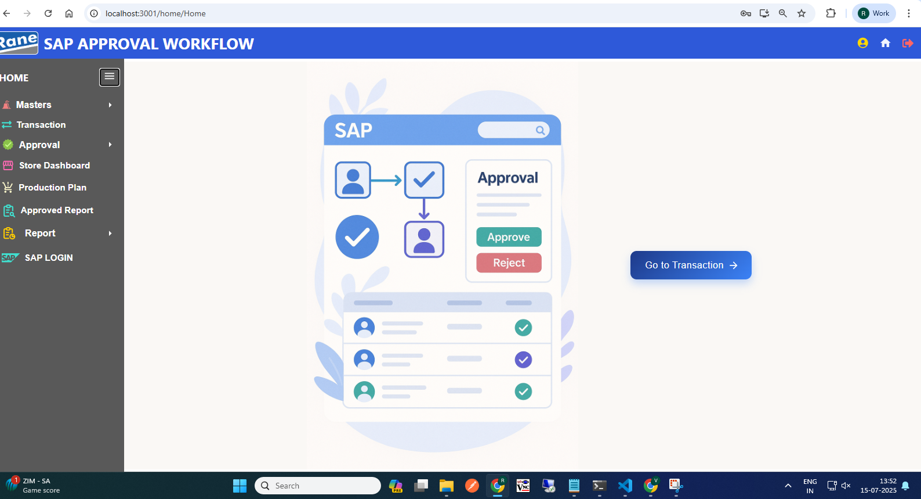
Login Page
Home Page
Click Here, go to the Transaction Dashboard

Slide 3
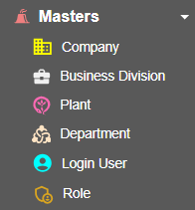
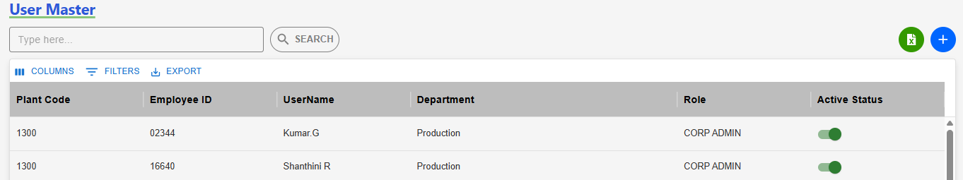
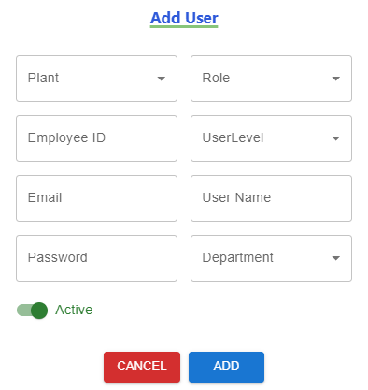
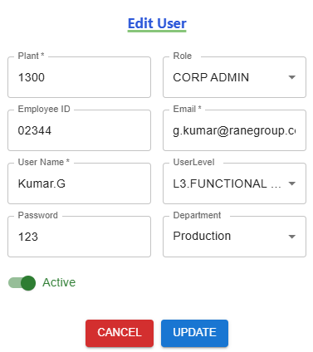
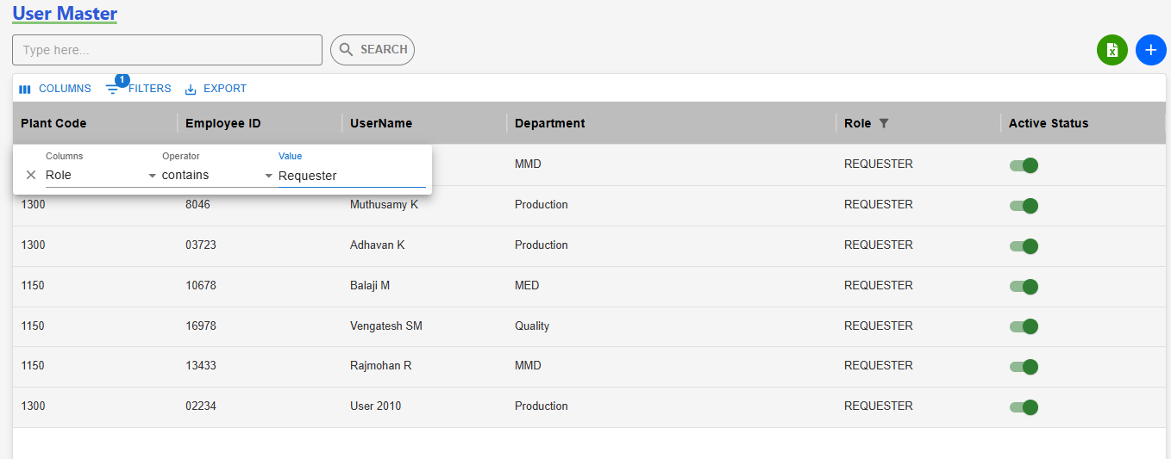
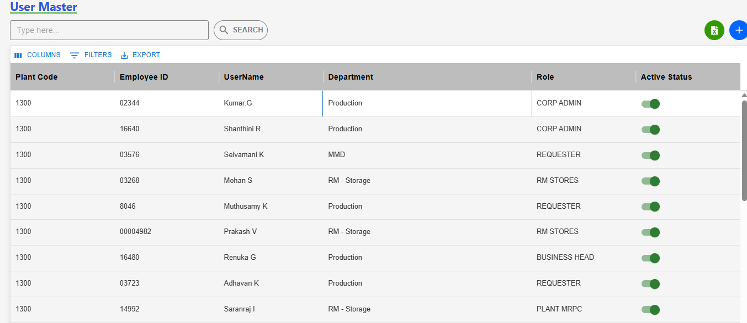
Login User (Admin)
(1)User Page Navigation
Home Page
(3) Add User
(2) Click here
Click here
(3) Edit User
(4) User’s Based On Company & Plant
(4) User’s Based On Company & Plant

Slide 4
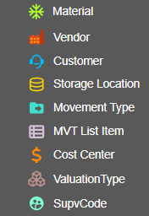
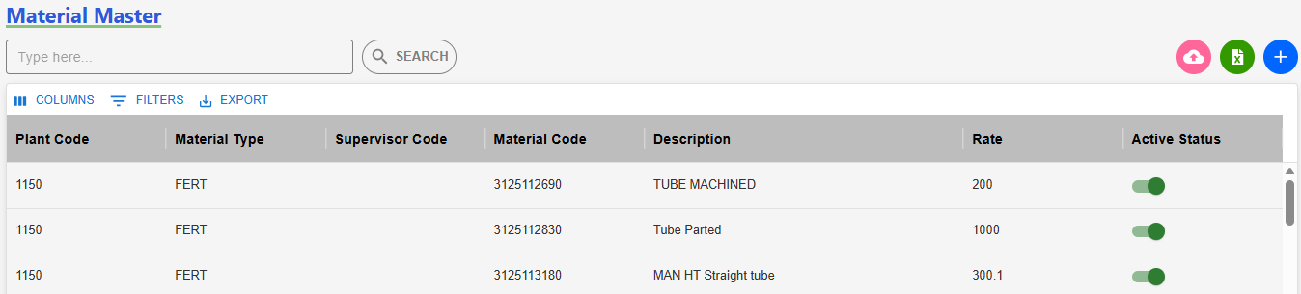
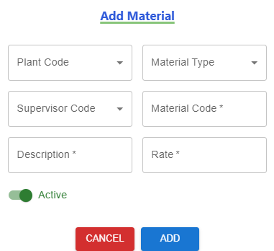
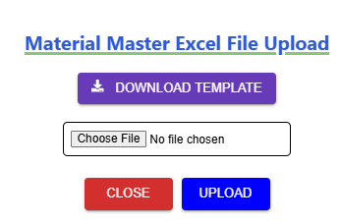
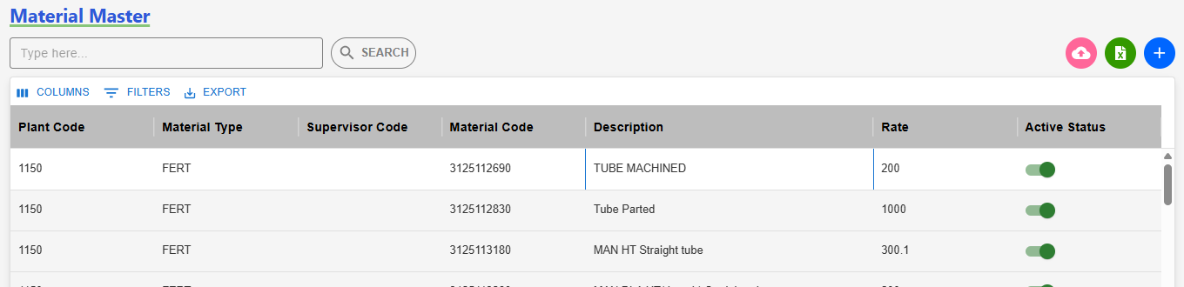
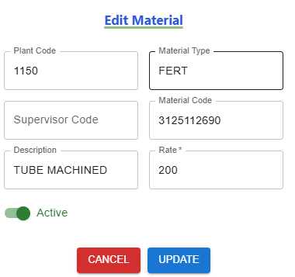
Material (Admin)
(1)Material Page Navigation
Home Page
(2) Add Single - Material
(1)Click here
(2)
(5) Bulk Upload - Material
(4) Material’s Based On Company & Plant
(3) Edit Material
(5)

Slide 5
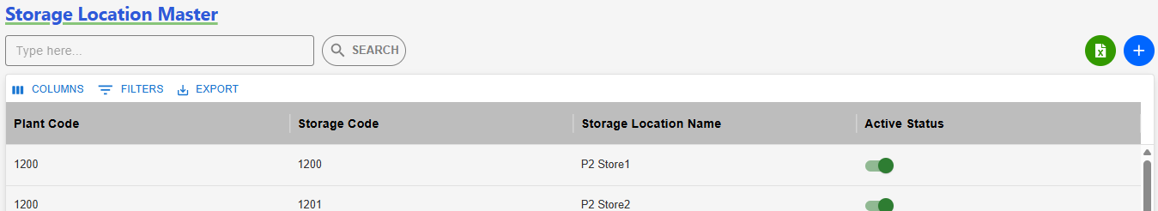
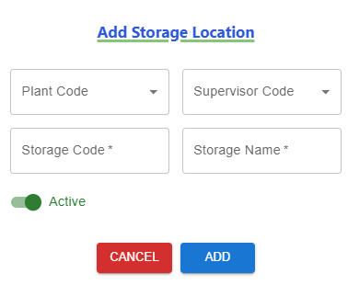
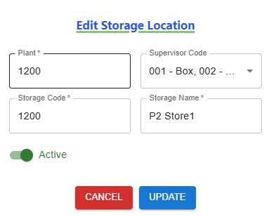
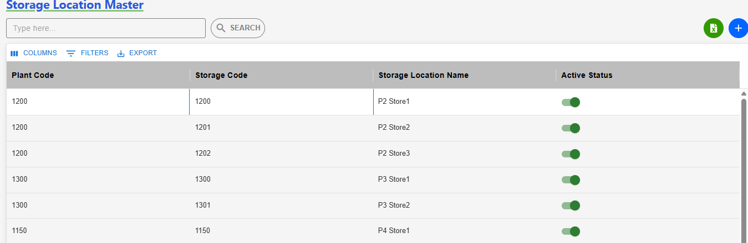
Storage Location (Admin)
(1)Storage Page Navigation
Home Page
(3) Add Storage
Click here
(2) Click here
(5) Edit Storage
(4) Storage Based On Company & Plant

Slide 6
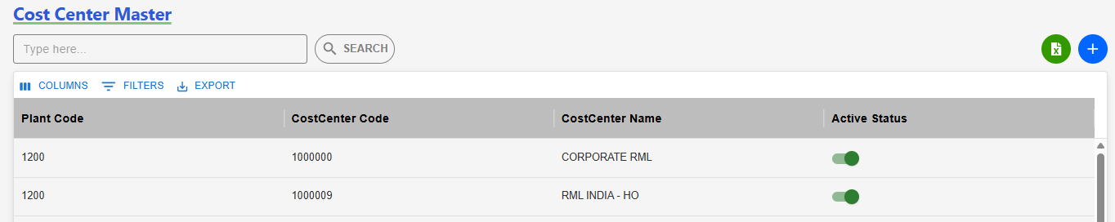
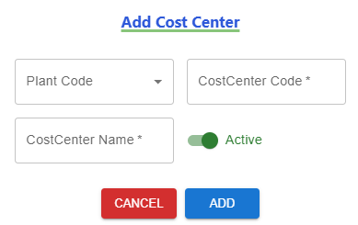
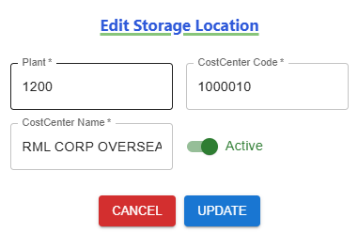
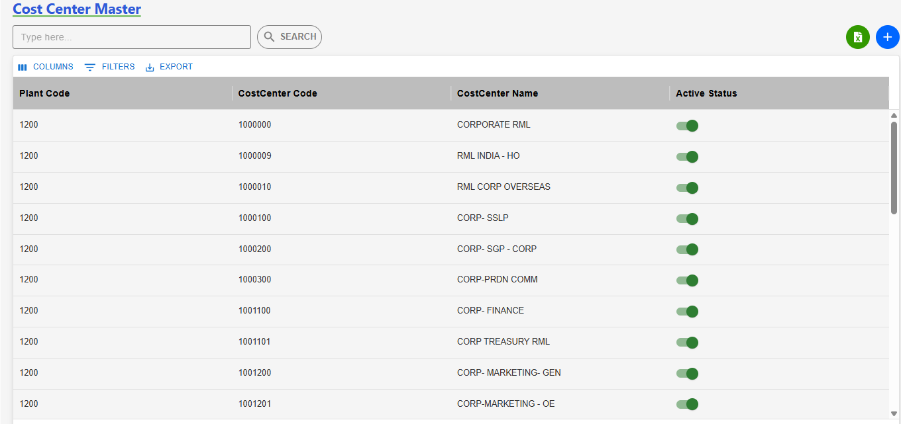
Cost Center (Admin)
(1)CostCenter Page Navigation
Home Page
(3) Add CostCenter
Click here
(2) Click here
(5) Edit CostCenter
(4) CostCenterBased On Company & Plant

Slide 7
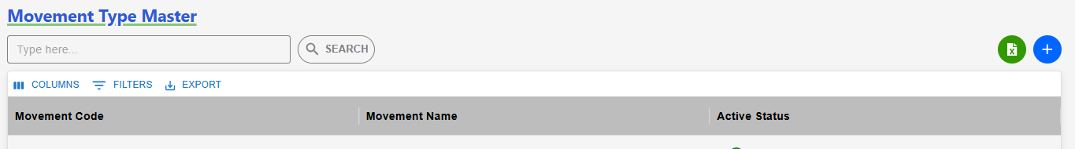
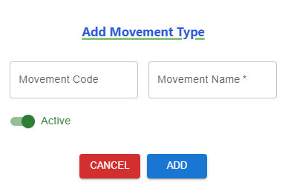
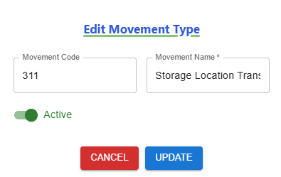
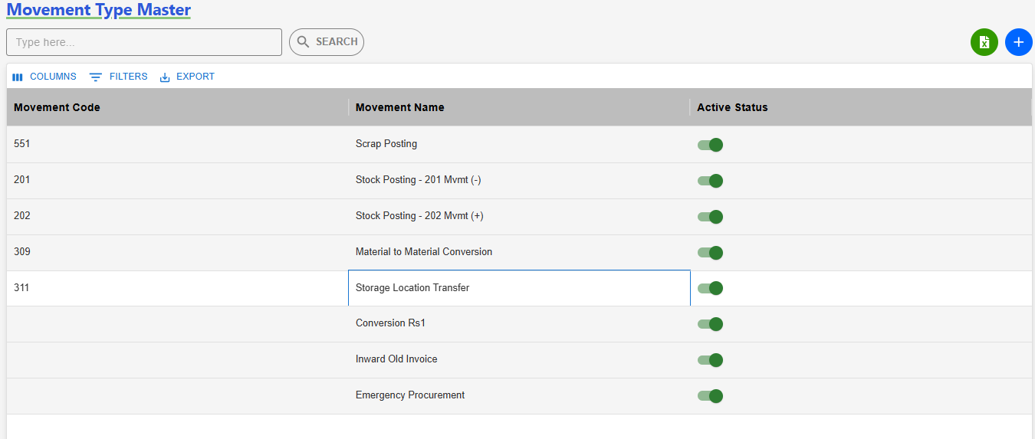
Movement (Admin)
(1)Movt Page Navigation
Home Page
(3) Add Movt
Click here
(2) Click here
(5) Edit User
(4) Movt Based On Company & Plant

Slide 8
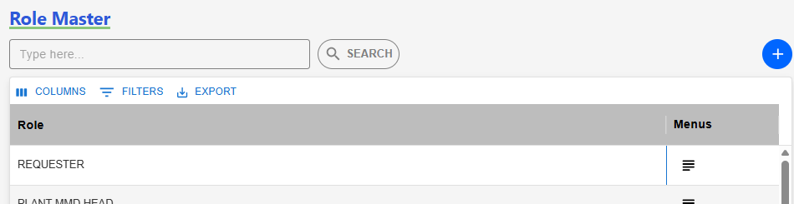
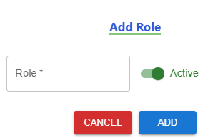
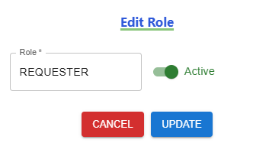
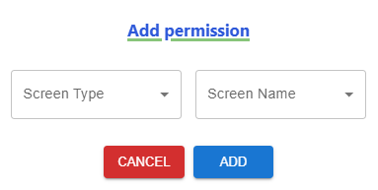
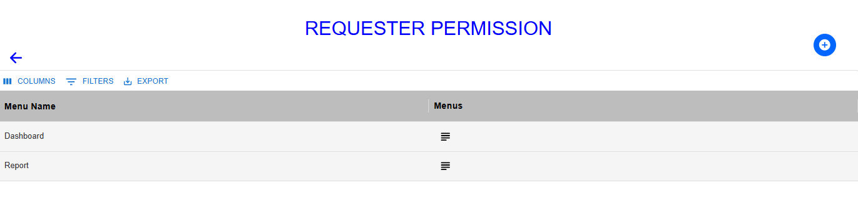
Role (Admin)
(1)Role Page Navigation
Home Page
(3) Add Role
(2) Click here
Click here
(5) Edit User
(5) Add the Permission Based On Role
(4) Add & Remove: Role Access

Slide 9
Material to Material Conversion
( 309 Movement )
User Manual - SAP approval workflow

Slide 10
309 Movement Transaction
Process workflow:
1.Create Request by Users ( PROD / MMD / QAD / MED )
2.Upload Process - Fill in required details
3. Upload Output:
i) New Records, ii) Error Records, iii)Duplicate Records
4. Submit for Approval to Level 1 User.
Level 1 : PLANT FINANCE HEAD
Level 2 : PLANT MRPC
Level 3 : PLANT HEAD
Level 4 : CORP FINANCE HEAD
Level 5 : CORP MRPC
5. Requester Page Visible Data: - Only data uploaded by the logged-in user,
Statuses: Pending, Under Query
6. Download Option: - Filtered by From–To Date & Movement Type
7. Editability: - Enabled only if status is Under Query
8. Resubmit Workflow: - Enabled only if status is Under Query Select rows using checkboxes After making corrections, click Re-submit

Slide 11
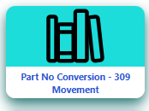
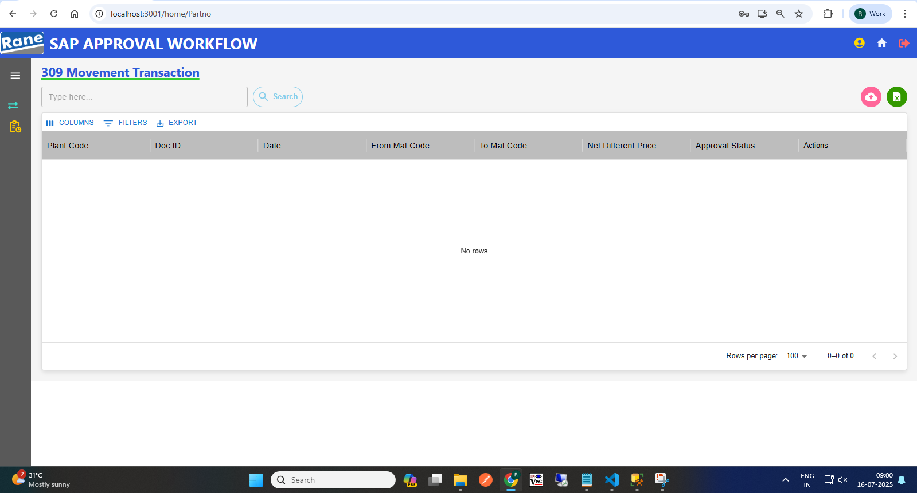
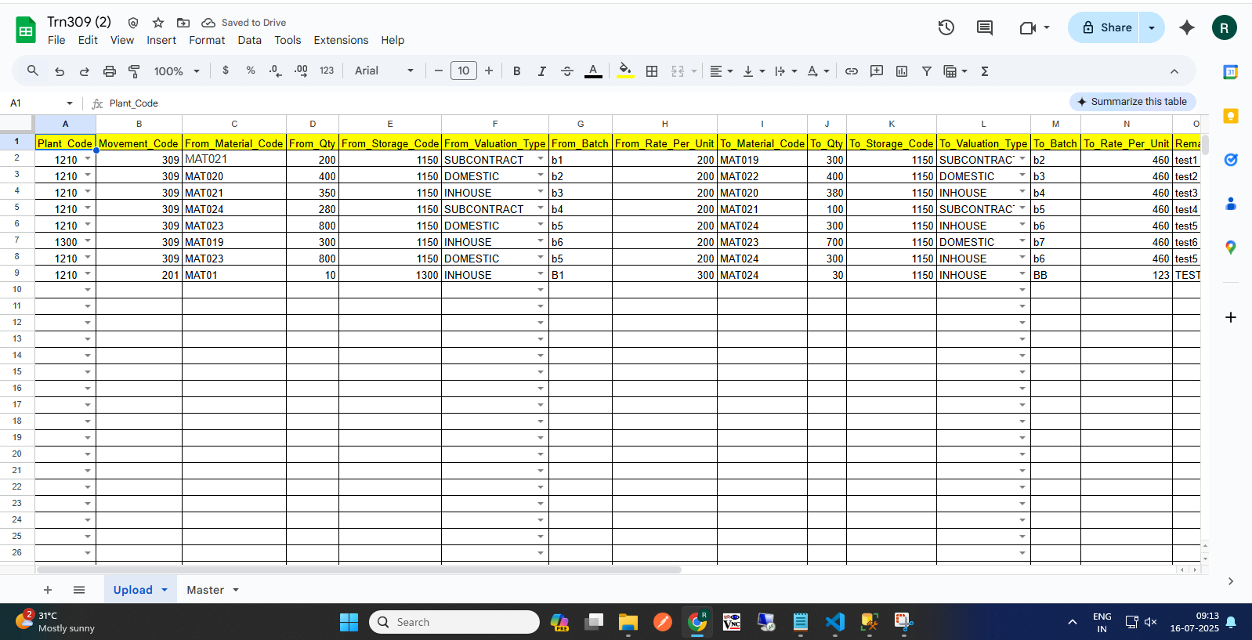
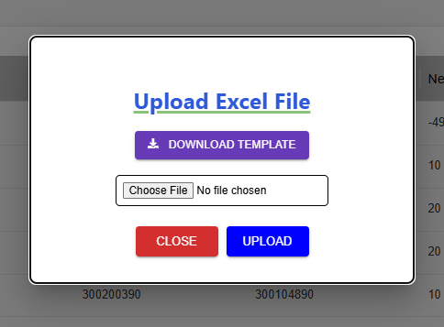
309 Movement Request (Requester)
(1)Transaction Page Navigation
(2)Click to begin a 309 request
Requester Page
Click here
(3) Click here to Download template
(4) Excel Template with Sample Data
(4) Upload
(5) Approval workflow
Request >>> L1 Approver: Plant Finance Head >>> L2 Approver: Plant MRPC >>> L3 Approver: Plant Head >>> L4 Approver: CORP Finance Head >>> L5 Approver: Corp MRPC >>> Send to SAP.

Slide 12
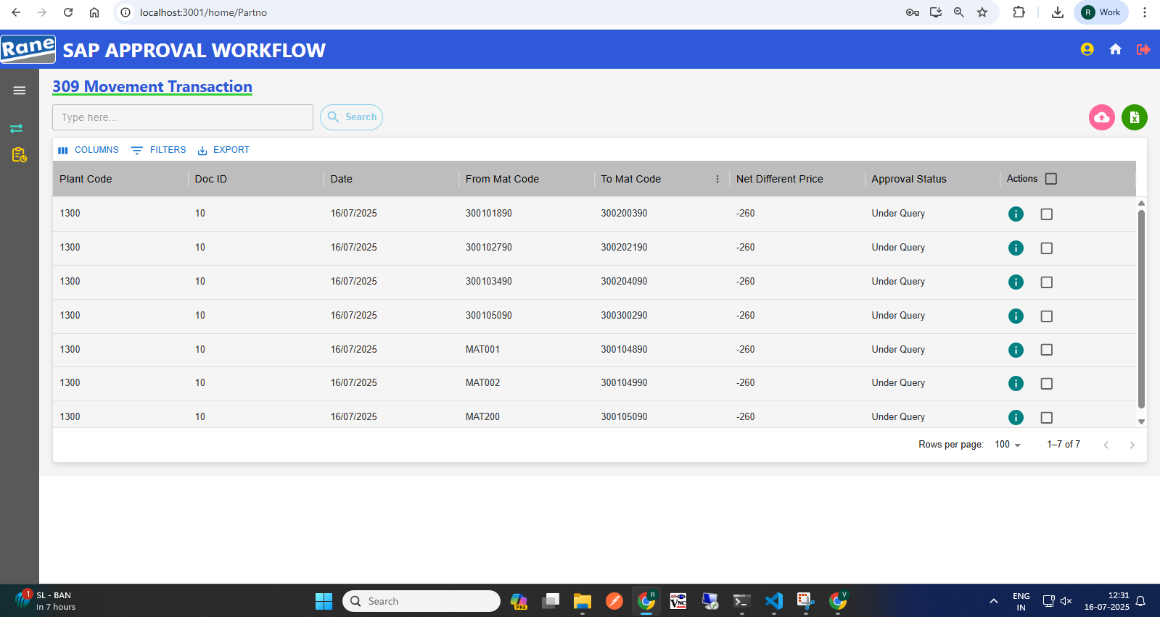
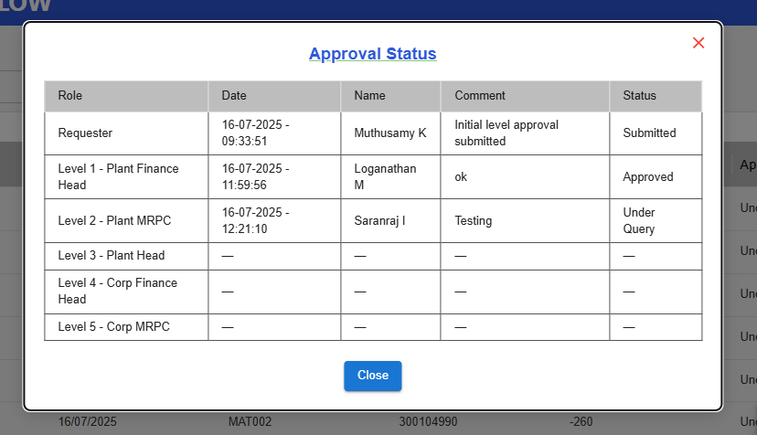
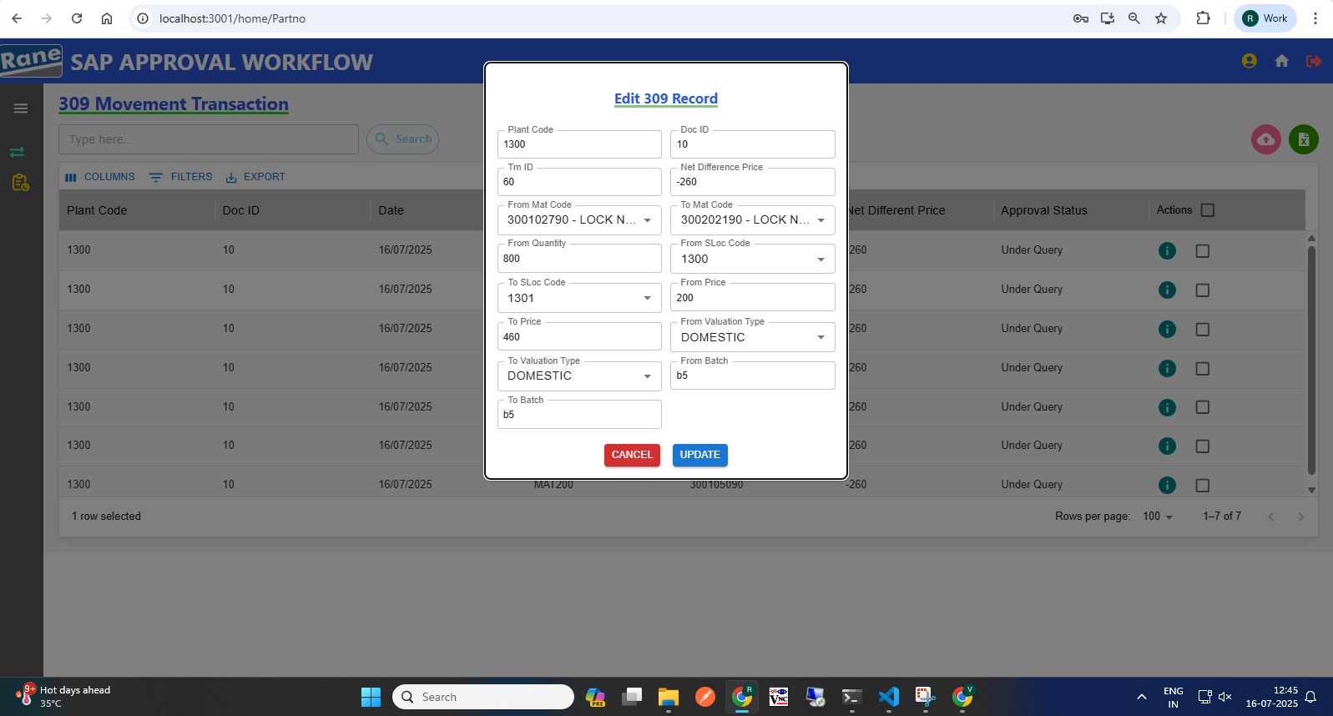
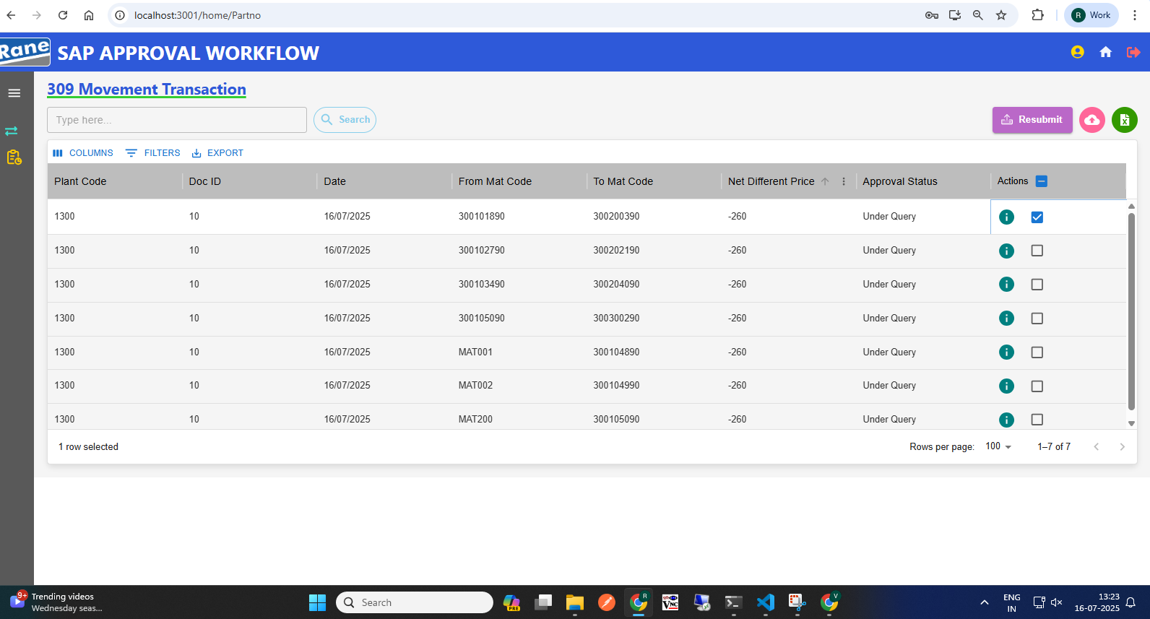
309 Movement: Edit with Status "Under Query" (Requester)
(1) Requester Page After "Under Query" Status
(2) View the Approval Level & Status
(3) Click Row to Edit Row, Then Update
Click here to View status
(4) Select Checkbox, Then Submit Data
Resubmit workflow
Status: Under Query>>> Edit>>> Re-submit>>>Send to Approver.

Slide 13
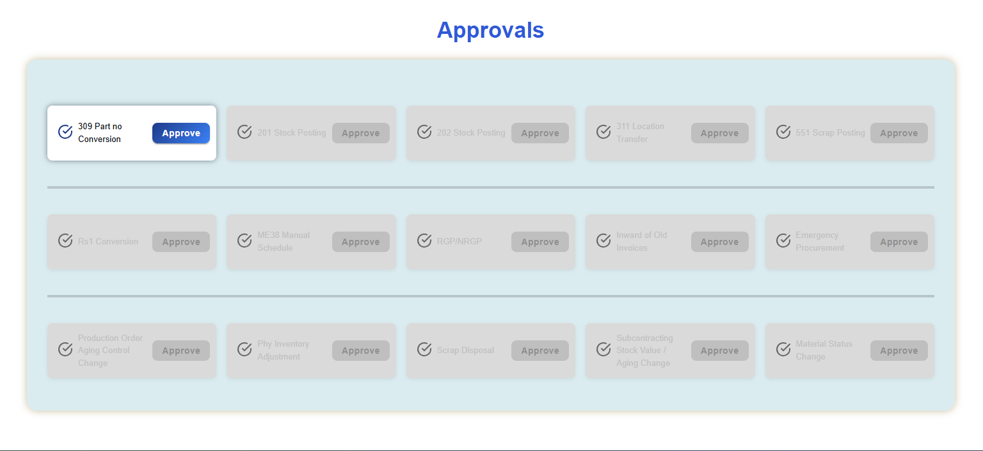
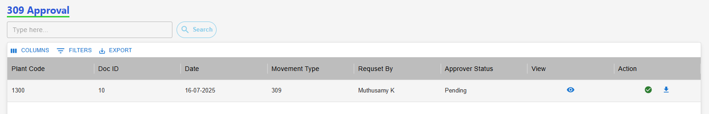
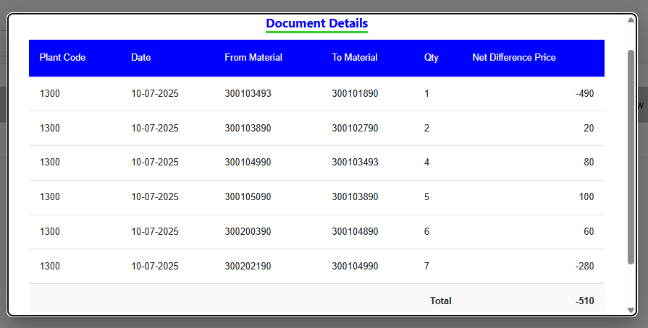
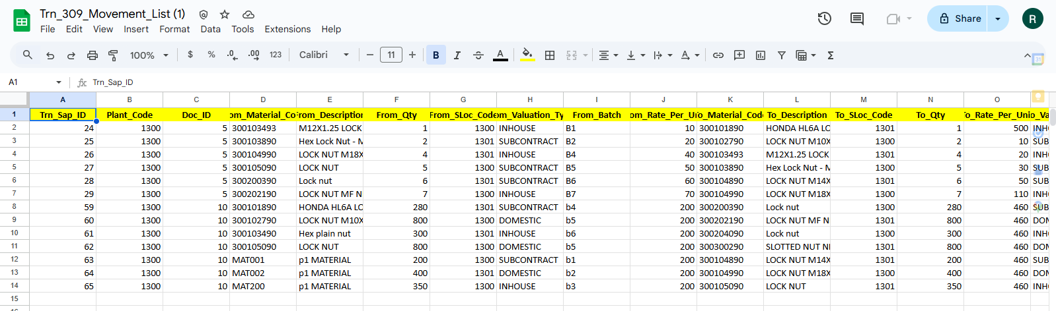
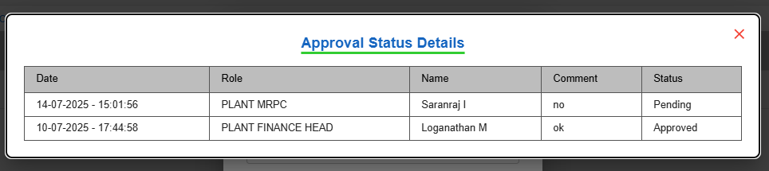
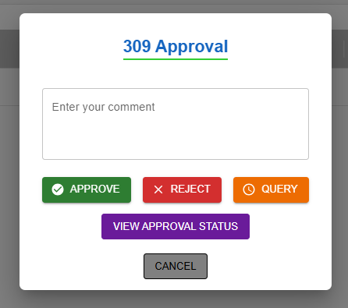
309 Movement Approval (Approver)
Approver Home Page
(2) View Net Difference, Download Records, Take Action
(3) View Details
(4)
(5)
(1) Click here, 309 Approval
(3)
(5) Click Download Icon to View Records
Click "View Approval Status" to See Last Update
(4) Action
Approver Make Action
Approval workflow: Request >>> L1 Approver: Plant Finance Head >>> L2 Approver: Plant MRPC >>> L3 Approver: Plant Head >>> L4 Approver: CORP Finance Head >>> L5 Approver: Corp MRPC

Slide 14
Stock Posting - 201 Mvmt (-)
( 201 Movement )
User Manual - SAP approval workflow

Slide 15
201 Movement Transaction
Process workflow:
1.Create Request by Users ( PROD / MMD / QAD / MED )
2.Upload Process - Fill in required details
3. Upload Output:
i) New Records, ii) Error Records, iii)Duplicate Records
4. Submit for Approval to Level 1 User.
Level 1 : PLANT FINANCE HEAD
Level 2 : PLANT MRPC
Level 3 : PLANT HEAD
Level 4 : CORP FINANCE HEAD
Level 5 : CORP MRPC
5. Requester Page Visible Data: - Only data uploaded by the logged-in user,
Statuses: Pending, Under Query
6. Download Option: - Filtered by From–To Date & Movement Type
7. Editability: - Enabled only if status is Under Query
8. Resubmit Workflow: - Enabled only if status is Under Query Select rows using checkboxes After making corrections, click Resubmit

Slide 16
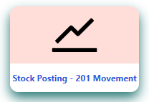
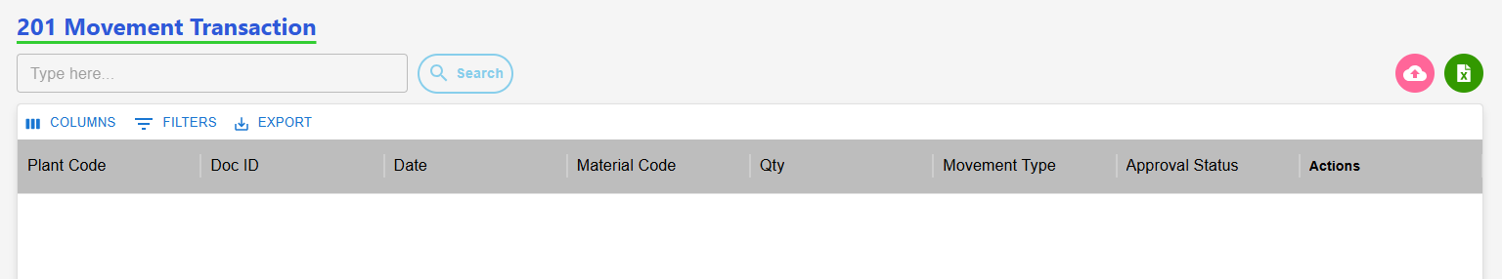
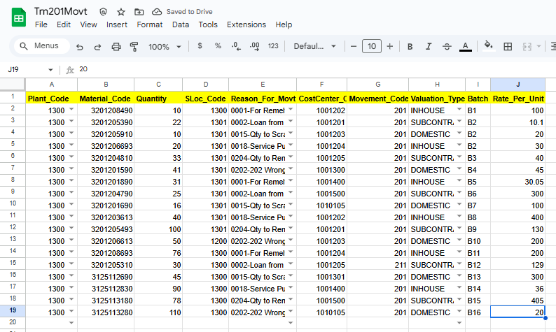
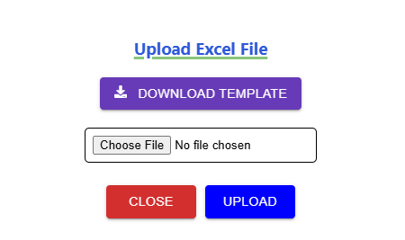
201 Movement Request (Requester)
(1)Transaction Page Navigation
(2)Click to begin a 201 request
201 Requester Page
Click here
(3) Click here to Download template
(4) Excel Template with Sample Data
(4) Upload
(6) Approval workflow
Request >>> L1 Approver: Plant Finance Head >>> L2 Approver: Plant MRPC >>> L3 Approver: Plant Head >>> L4 Approver: CORP Finance Head >>> L5 Approver: Corp MRPC >>> Send to SAP.

Slide 17
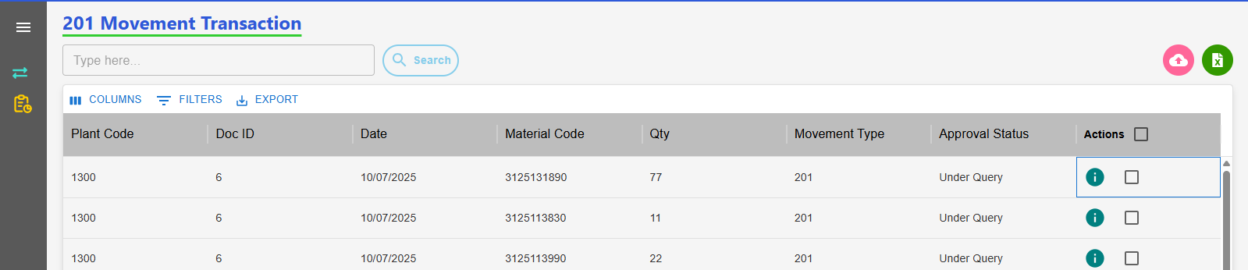



201 Movement: Edit with Status "Under Query" (Requester)
Requester Page After "Under Query" Status
(2) View the Approval Level & Status
(3) Click Row to Edit, Then Update
(1) Click here to View status
(4) Select Checkbox, Then Re-Submit Data
Resubmit workflow
Status: Under Query>>> Edit>>> Re-submit>>>Send to Approver.

Slide 18





201 Movement Approval (Approver)
Approver Home Page
(2) Approver Page
(3) View Details
(4)
(1) Click here, 201 Approval
(3)
(7)Action
(6) Click Download Icon to View Records
Click "View Approval Status" to See Last Update
Approver Make Action
Approval workflow: Request >>> L1 Approver: Plant Finance Head >>> L2 Approver: Plant MRPC >>> L3 Approver: Plant Head >>> L4 Approver: CORP Finance Head >>> L5 Approver: Corp MRPC

Slide 19
Stock Posting - 202 Mvmt (+)
( 202 Movement )
User Manual - SAP approval workflow

Slide 20
202 Movement Transaction
Process workflow:
1.Create Request by Users ( PROD / MMD / QAD / MED )
2.Upload Process - Fill in required details
3. Upload Output:
i) New Records, ii) Error Records, iii)Duplicate Records
4. Submit for Approval to Level 1 User.
Level 1 : PLANT FINANCE HEAD
Level 2 : PLANT MRPC
Level 3 : PLANT HEAD
Level 4 : CORP FINANCE HEAD
Level 5 : CORP MRPC
5. Requester Page Visible Data: - Only data uploaded by the logged-in user,
Statuses: Pending, Under Query
6. Download Option: - Filtered by From–To Date & Movement Type
7. Editability: - Enabled only if status is Under Query
8. Resubmit Workflow: - Enabled only if status is Under Query Select rows using checkboxes After making corrections, click Resubmit

Slide 21



202 Movement Request (Requester)
(1)Transaction Page Navigation
(2)Click to Start a 202 Request
202 Requester Page
Click here
(3) Click here to Download template
(5) Excel Template with Sample Data
(4) Upload
(6) Approval workflow
Request >>> L1 Approver: Plant Finance Head >>> L2 Approver: Plant MRPC >>> L3 Approver: Plant Head >>> L4 Approver: CORP Finance Head >>> L5 Approver: Corp MRPC >>> Send to SAP.

Slide 22




202 Movement: Edit with Status "Under Query" (Requester)
Requester Page After "Under Query" Status
(2) View the Approval Level & Status
(3) Click Row to Edit, Then Update
(1) Click here to View status
(4) Select Checkbox, Then Submit Data
Resubmit workflow
Status: Under Query>>> Edit>>> Re-submit>>>Send to Approver.

Slide 23





202 Movement Approval (Approver)
Approver Home Page
(2) Approver Page
(3) View Details
(4)
(3)
(5)Action
(4) Click Download Icon to View Records
Click "View Approval Status" to See Last Update
Approver Make Action
Approval workflow: Request >>> L1 Approver: Plant Finance Head >>> L2 Approver: Plant MRPC >>> L3 Approver: Plant Head >>> L4 Approver: CORP Finance Head >>> L5 Approver: Corp MRPC

Slide 24
Scrap Posting
( 551 Movement )
User Manual - SAP approval workflow

Slide 25
551 Movement Transaction
Process workflow:
1.Create Request by Users ( PROD / MMD / QAD / MED )
2.Upload Process - Fill in required details
3. Upload Output:
i) New Records, ii) Error Records, iii)Duplicate Records
4. Submit for Approval to Level 1 User.
Level 1 : PLANT FINANCE HEAD
Level 2 : PLANT MRPC
Level 3 : PLANT HEAD
Level 4 : CORP FINANCE HEAD
Level 5 : BUSINESS HEAD
Level 6 : CORP MRPC
5. Requester Page Visible Data: - Only data uploaded by the logged-in user,
Statuses: Pending, Under Query
6. Download Option: - Filtered by From–To Date & Movement Type
7. Editability: - Enabled only if status is Under Query
8. Resubmit Workflow: - Enabled only if status is Under Query Select rows using checkboxes After making corrections, click Resubmit

Slide 26



551 Movement Request (Requester)
(1)Transaction Page Navigation
(2)Click to Start a 551 Request
551 Requester Page
Click here
(3) Click here to Download template
(5) Excel Template with Sample Data
(4) Upload
(6) Approval workflow
Request >>> L1 Approver: Plant Finance Head >>> L2 Approver: Plant MRPC >>> L3 Approver: Plant Head >>> L4 Approver: CORP Finance Head >>> L5 Approver: Business Head>>> L6 Approver: Corp MRPC >>> Send to SAP.

Slide 27




551 Movement: Edit with Status "Under Query" (Requester)
Requester Page After "Under Query" Status
(2) View the Approval Level & Status
(3) Click Row to Edit, Then Update
(1) Click here to View status
(4) Select Checkbox, Then Submit Data
Resubmit workflow
Status: Under Query>>> Edit>>> Re-submit>>>Send to Approver.

Slide 28




551 Movement Approval (Approver)
Approver Home Page
(2) Approver Page
(3) View Details
(4)
(3)
(5)Action
(4) Click Download Icon to View Records
Click "View Approval Status" to See Last Update
Approver Make Action
Approval workflow: Request >>> L1 Approver: Plant Finance Head >>> L2 Approver: Plant MRPC >>> L3 Approver: Plant Head >>> L4 Approver: CORP Finance Head >>> L5 Approver: Business Head>>> L6 Approver: Corp MRPC

Slide 29
Storage Location Transfer
( 311 Movement )
User Manual - SAP approval workflow

Slide 30
311 Movement Transaction
Process workflow:
1.Create Request by Users ( PROD / MMD / QAD / MED )
2.Upload Process - Fill in required details
3. Upload Output:
i) New Records, ii) Error Records, iii)Duplicate Records
4. Submit for Approval to Level 1 User.
Level 1 : PLANT MRPC
5. Requester Page Visible Data: - Only data uploaded by the logged-in user,
Statuses: Pending, Under Query
6. Download Option: - Filtered by From–To Date & Movement Type
7. Editability: - Enabled only if status is Under Query
8. Resubmit Workflow: - Enabled only if status is Under Query Select rows using checkboxes After making corrections, click Resubmit

Slide 31



311 Movement Request (Requester)
(1)Transaction Page Navigation
(2)Click to Start a 311 Request
311 Requester Page
Click here
(3) Click here to Download template
(5) Excel Template with Sample Data
(4) Upload
(6) Approval workflow
Request >>> L1 Approver: Plant MRPC >>> Send to SAP.

Slide 32




551 Movement: Edit with Status "Under Query" (Requester)
Requester Page After "Under Query" Status
(2) View the Approval Level & Status
(3) Click Row to Edit, Then Update
(1) Click here to View status
(4) Select Checkbox, Then Submit Data
Resubmit workflow
Status: Under Query>>> Edit>>> Re-submit>>>Send to Approver.

Slide 33





551 Movement Approval (Approver)
Approver Home Page
(2) Approver Page
(3) View Details
(4)
(3)
(5)Action
(4) Click Download Icon to View Records
Click "View Approval Status" to See Last Update
Approver Make Action
Approval workflow: Request >>> L1 Approver: Plant MRPC

Slide 34
Conversion Rs1
( RS.1 Movement )
User Manual - SAP approval workflow

Slide 35
Rs.1 Movement Transaction
Process workflow:
1.Create Request by Users ( PROD / MMD / QAD / MED )
2.Upload Process - Fill in required details
3. Upload Output:
i) New Records, ii) Error Records, iii)Duplicate Records
4. Submit for Approval to Level 1 User.
Level 1 : PLANT FINANCE HEAD
Level 2 : PLANT HEAD
Level 3 : CORP FINANCE HEAD
Level 4 : BUSINESS HEAD
5. Requester Page Visible Data: - Only data uploaded by the logged-in user,
Statuses: Pending, Under Query
6. Download Option: - Filtered by From–To Date & Movement Type
7. Editability: - Enabled only if status is Under Query
8. Resubmit Workflow: - Enabled only if status is Under Query Select rows using checkboxes After making corrections, click Resubmit

Slide 36



Rs.1 Movement Request (Requester)
(1)Transaction Page Navigation
(2)Click to Start a Rs.1 Request
Rs.1 Requester Page
Click here
(3) Click here to Download template
(5) Excel Template with Sample Data
(4) Upload
(6) Approval workflow
Request >>> L1 Approver: Plant Finance Head >>> L2 Approver: Plant Head >>> L3 Approver: CORP Finance Head >>> L4 Approver: Business Head >>> Send to SAP.

Slide 37



Rs.1 Movement: Edit with Status "Under Query" (Requester)
Requester Page After "Under Query" Status
(2) View the Approval Level & Status
(3) Click Row to Edit, Then Update
(1) Click here to View status
(4) Select Checkbox, Then Submit Data
Resubmit workflow
Status: Under Query>>> Edit>>> Re-submit>>>Send to Approver.

Slide 38





Rs.1 Movement Approval (Approver)
Approver Home Page
(2) Approver Page
(3) View Details
(34)
(3)
(5)Action
(4) Click Download Icon to View Records
Click "View Approval Status" to See Last Update
Approver Make Action
Approval workflow: Request >>> L1 Approver: Plant Finance Head >>> L2 Approver: Plant Head >>> L3 Approver: CORP Finance Head >>> L4 Approver: Business Head

Slide 39
Inward Old Invoice
( Purchase)
User Manual - SAP approval workflow

Slide 40
Inward of Old Invoices (Purchase) Movement Transaction
Process For Purchase workflow:
1.Create Request by Users ( PROD / MMD / QAD / MED )
2.Add Process - Fill in required details
3. Submit for Approval to Level 1 User
Purchase Approval Workflow
Case (i): If invoice date is less than 1 year: Level 1: Corp MRPC approves → Send to SAP
Case (ii): If invoice date is more than 1 year: Level 1: Corp MRPC reviews and sends to: Level 2: Corp Finance Head or Corp MMD Head. If approved → Send to SAP
4. Requester Page Visible Data: - Only data uploaded by the logged-in user,
Statuses: Waiting, New, Rejected
5. Download Option: - Filtered by From–To Date
6. Editability: - Enabled only if status is Waiting, New, Rejected
Select rows using Edit After making corrections, Resubmit

Slide 41



Inward of Old Invoices Purchase Request (Requester)
(1)Transaction Page Navigation
(2)Click to Start a Purchase Request
Purchase Requester Page
(3)Click here to add Purchase
Click here
(4) Add
Approval workflow: Request >>> Follows Case (i) or Case (ii) based on Invoice Date:
Case (i): Invoice < 1 Year. Level 1: Corp MRPC >>> Send to SAP
Case (ii): Invoice > 1 Year. Level 1: Corp MRPC >>> Level 2: Corp Finance Head or Corp MMD Head>>> Send to SAP

Slide 42





Inward of Old Invoices Purchase Resubmit (Requester)
(2)Click to Start a 201 Request
(2)Clic(2)Click to Start a 201 Request
k to Start a 201 Request
(1)Requester Page After Rejected
(2) View the Approval Level & Status
(3)Click Row to Edit Purchase
(4)
(3)
(5)After editing, add a comment & Resubmit
(4)Click Here to Resubmit
Approval workflow: Request >>> Follows Case (i) or Case (ii) based on Invoice Date:
Case (i): Invoice < 1 Year. Level 1: Corp MRPC >>> Send to SAP
Case (ii): Invoice > 1 Year. Level 1: Corp MRPC >>> Level 2: Corp Finance Head or Corp MMD Head>>> Send to SAP

Slide 43




Inward of Old Invoices Purchase Approval (Approver)
Approver Home Page
(2) Approver Page
(3) View Details
(3)
(4)
(4)Action
Approver workflow : Case (i): Invoice < 1 Year. Level 1: Corp MRPC >>> Send to SAP
Case (ii): Invoice > 1 Year. Level 1: Corp MRPC >>> Level 2: Corp Finance Head or Corp MMD Head >>> Send to SAP

Slide 44
Inward Old Invoice
( Service )
User Manual - SAP approval workflow

Slide 45
Inward of Old Invoices (Service) Movement Transaction
Process For Service workflow:
1.Create Request by Users ( PROD / MMD / QAD / MED )
2.Add Process - Fill in required details
3.Submit for Approval to Level 1 User.
Level 1 : PLANT FINANCE HEAD
Level 2 : CORP MRPC
Level 3 : CORP FINANCE HEAD
5. Requester Page Visible Data: - Only data uploaded by the logged-in user,
Statuses: Waiting, New, Rejected
6. Download Option: - Filtered by From–To Date
7. Editability: - Enabled only if status is Waiting, New, Rejected
Select rows using Edit After making corrections, Resubmit

Slide 46


Inward of Old Invoices Service Request (Requester)
(1)Transaction Page Navigation
(2)Click to Start a Service Request
Service Requester Page
Click here
Click here to add Service
(4) Add Service
(5) Approval workflow
Request >>> L1 Approver: Plant Finance Head >>> L2 Approver: CORP MRPC >>> L3 Approver: CORP Finance Head >>> Send to SAP.

Slide 47



Inward of Old Invoices Purchase Resubmit (Requester)
(1)Requester Page After Rejected
(2) View the Approval Level & Status
(3)Click Row to Edit Purchase
(4)
(3)
(5)After editing, add a comment & Resubmit
(4)Click Here to Resubmit
(6) Approval workflow
Request >>> L1 Approver: Plant Finance Head >>> L2 Approver: CORP MRPC >>> L3 Approver: CORP Finance Head >>> Send to SAP.

Slide 48



Inward of Old Invoices Service Movement Transaction Approval (Approver)
(1)Approver Home Page
(2) View Records
(3) Action
(3)
Approver Make Action
Approval workflow: Request >>> L1 Approver: Plant Finance Head >>> L2 Approver: CORP MRPC >>> L3 Approver: CORP Finance Head.

Slide 49
Emergency Procurement
( Emergency )
User Manual - SAP approval workflow

Slide 50
Emergency Procurement Movement Transaction
Process For Purchase workflow:
1.Create Request by Users ( PROD / MMD / QAD / MED )
2.Add Process - Fill in required details
3.Submit for Approval to Level 1 User.
Level 1 : PLANT MRPC
Level 2 : PLANT FINANCE HEAD
Level 3 : PLANT HEAD (after 3 approval finished mail trigger to the gate office)
5. Requester Page Visible Data: - Only data uploaded by the logged-in user,
Statuses: Waiting, New, Rejected
6. Download Option: - Filtered by From–To Date
7. Editability: - Enabled only if status is Waiting, New, Rejected
Select rows using Edit After making corrections, Resubmit
Purchase Order Insert Later (If Not Update PO Mail Trigger TO Approval’s)

Slide 51



Emergency Procurement Request (Requester)
(1)Transaction Page Navigation
(2)Click to Start a Service Request
Service Requester Page
Click here
Click here to add Service
(4) Add Service
(6) Approval workflow
Request >>> L1 Approver: Plant MRPC >>> L2 Approver: Plant Finance Head >>> L3 Approver: Plant Head.

Slide 52



Emergency Procurement Movement Transaction Resubmit (Requester)
(1)Requester Page After Rejected
(2) View the Approval Level & Status
(3)Click Row to Edit Purchase
(4)
(3)
(5)After editing, add a comment & Resubmit
(4)Click Here to Resubmit
(6) Approval workflow
Request >>> L1 Approver: Plant MRPC >>> L2 Approver: Plant Finance Head >>> L3 Approver: Plant Head.

Slide 53


Emergency Procurement Movement Transaction Approval (Approver)
(1)Approver Home Page
(2) View Records
(3) Action
(3)
(4) Approver Make Action
Approval workflow: Request >>> L1 Approver: Plant MRPC >>> L2 Approver: Plant Finance Head >>> L3 Approver: Plant Head.

Slide 54
Approved Reports
User Manual - SAP approval workflow

Slide 55




Approved Reports Page(Corp MRPC)
(1)Reports Page Navigation
(2)Select The Transaction
(3)Download Movt Reports
Click here
(4) Reports
Workflow: Secure access for Corp MRPC users only. Select Movement Type → Set Date → Download

Slide 56
Thank you

